Slide 1


A Systematic evaluation of the operational 3D-VAR WRF model in Colombian Air Force
System for data assimilation validation and functional data analysis purposes
Juan Soto, Jhon Edinson, Bibiana Boada, Sara Lorduy, Kevin Chicaeme, Julian Pantoja, Santiago Lopez Restrepo, David Ortega, Andrés Yarce Botero, Olga Lucia Quintero
Material presented in the 2nd International Workshop on Data Assimilation and decision making, Medellín, Colombia
1

Slide 2
Outline
A Systematic evaluation of the operational 3D-VAR WRF model in Colombian Air Force
System for data assimilation validation and functional data análisis purposes

Slide 3
A Systematic evaluation of the operational 3D-VAR WRF model in Colombian Air Force

Slide 4
Static WRF data
FAC WRF assimilated
Validation Observations
Validation
GFS initial and boundary condition
REAL
WPS
Statistical metrics comparison
WRFDA
GOES 16
RADAR
METAR
SYNOP
SONDES
Obsproc
Quality control
ARW
WRF
FAC WRF no assimilated
WPS
GFS initial and boundary condition
4

Slide 5
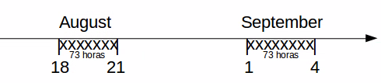
Methodology
Assimilated vs no assimilated
T2 Temperature
P Pressure Surface and levels
V10 Velocity V
U10 Velocity U
Precipitation
2020
Codes availables at:
https://github.com/ayarceb/WRFDA_FAC_EAFIT
Simulated data available at:
https://eafit-my.sharepoint.com/:f:/g/personal/ayarceb_eafit_edu_co/EuHk4-UZVQ9JqayzFwaCUfgBVkQnS9kbxWZGwNJvaX9uLg
Link to paper
https://www.overleaf.com/8722379979vxqbpmkntpsx
5

Slide 6
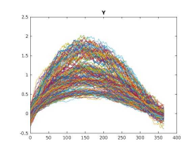
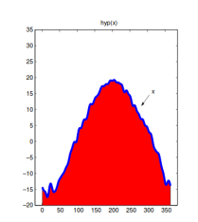
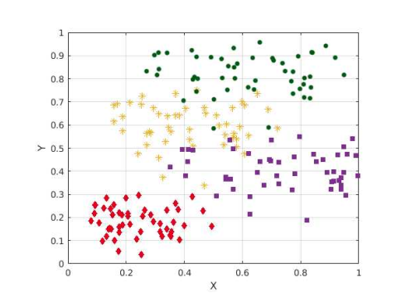
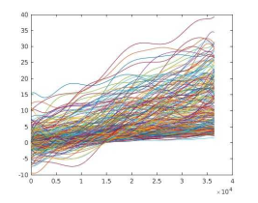
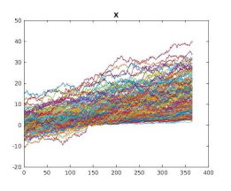
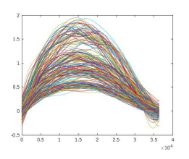
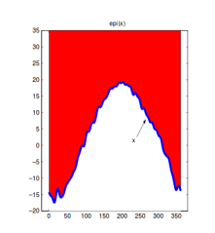
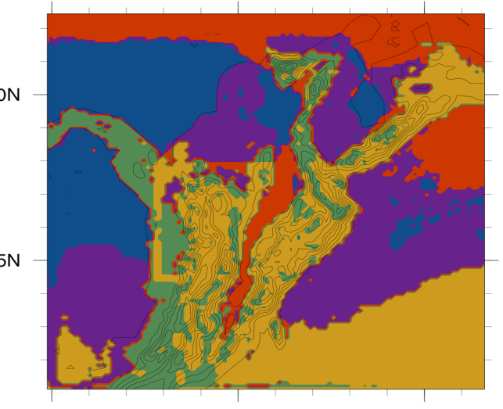
Experimentos actuales datos funcionales
Y
Hypograph
characterization
x
Signal acquisition
Signal smoothing
6
Hypograph projection

Slide 7
Experimentos actuales datos funcionales
Selección de dos variables para estudio
Precipitación
Temperatura
Ventanas de tiempo (2)
Comenzar con la primer semana
WRF
1er experimento
WRFDA
WRF
WRFDA
WRF
3do experimento
Sondas
2do experimento
WRFDA
Radar
Precipitación
Satélite
Temperatura
Limitar el paper hasta estos resultados
Considerar paquetes de observaciones diferentes

Slide 8
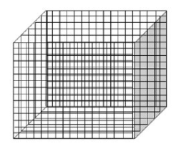
Experimentos actuales datos funcionales
Nuevas estrategias de validación en un dominio espacial combinando análisis de datos funcionales
Leveles
Longitude
Latitude
Grupo de datos de observaciones, e.g. precipitación
Estado del modelo ó observación, e.g. precipitación

Slide 9
System for data assimilation validation and functional data analysis purposes

Slide 10
Estructura integración de los códigos de observaciones
Github base https://github.com/ayarceb/WRFDA_FAC_EAFIT
Usuario → ingresa Fecha → selecciona observaciones
Sondas (multi-descarga, extracción variables de interés)
Metar (multi-descarga, extracción P y T)
Radar (Extracción desde el Little R de las variables de interés)
GOES (técnica de remapeo desde las imágenes, normalización)
Unidades aeroportadas Simple (unidades complementarias de información de calidad de aire y meteorología)
Matrices “Hipercubos”
Información interpolada espacio-temporalmente a la resolucion del modelo operativo WRFDA FAC
Pipeline descarga, preprocesamiento y análisis de datos de diferentes observaciones sobre el territorio Colombiano
10

Slide 11
Pipeline “The system”. observations and models
Time range selection
Observation selection
- Station selection
- Spatial resolution of the cube to generate
user
Model
Observations
WRF
WRFDA
3DVar
Sondas
METAR
Satellite (GOES
Sentinel-5
Sentinel-2)
RADAR
Precipitación
IDEAM
Simple unit
Download
Download
Download
Download
Download
Download
Generate matrix
Generate matrix
Generate matrix
Generate matrix
Generate matrix
Generate matrix
Export different formats
user
CSV, .mat, .nc
Matrix interface
Base de datos
Data assimilation validation purposes
Back end
Robust functional data analysis purposes
Front end

Slide 12
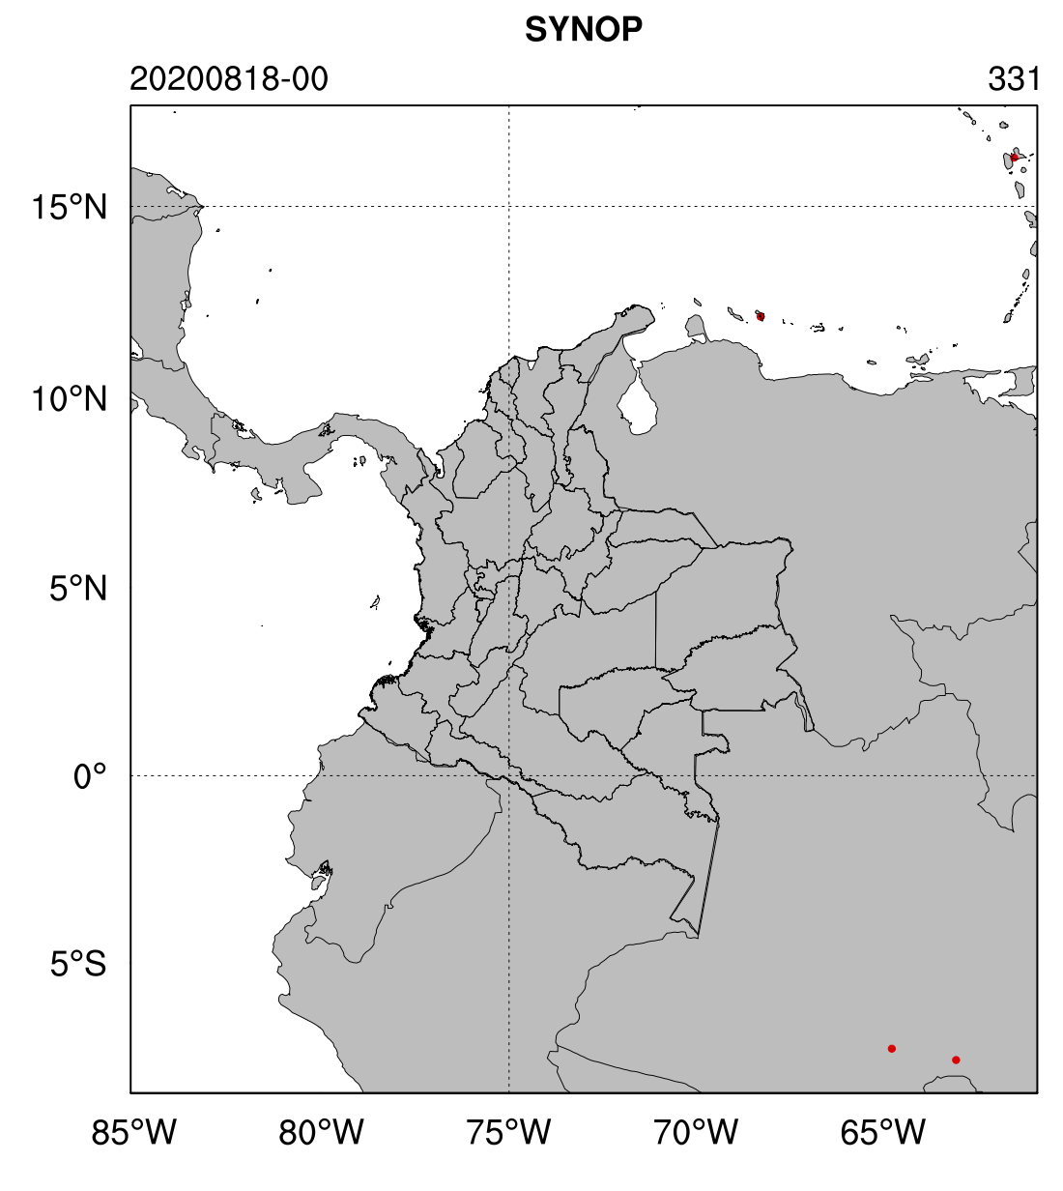
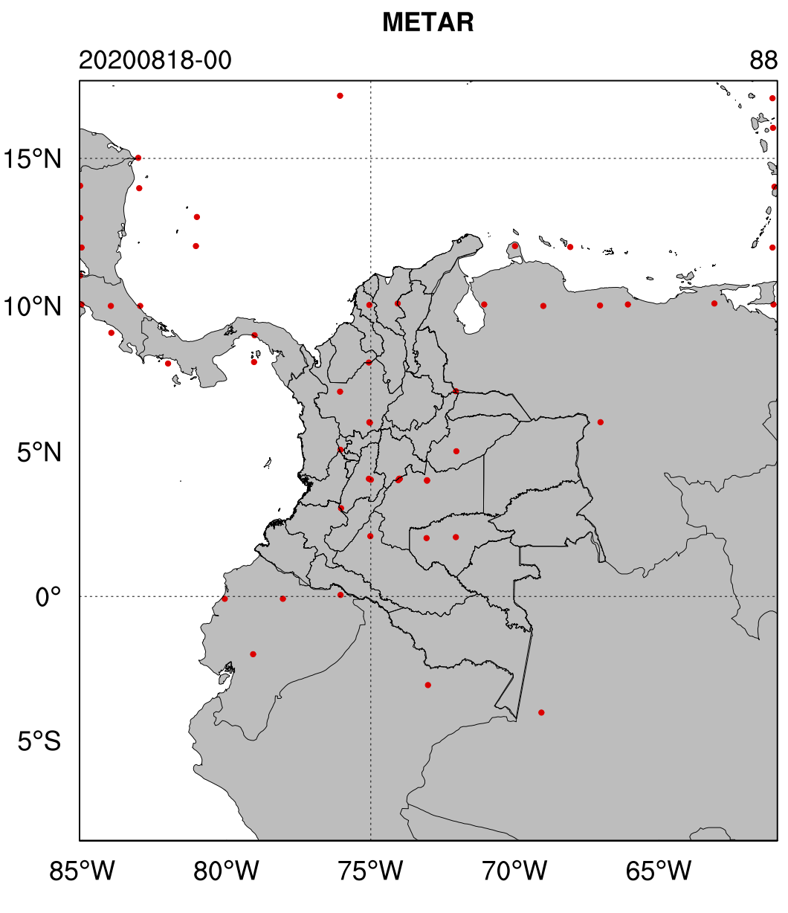
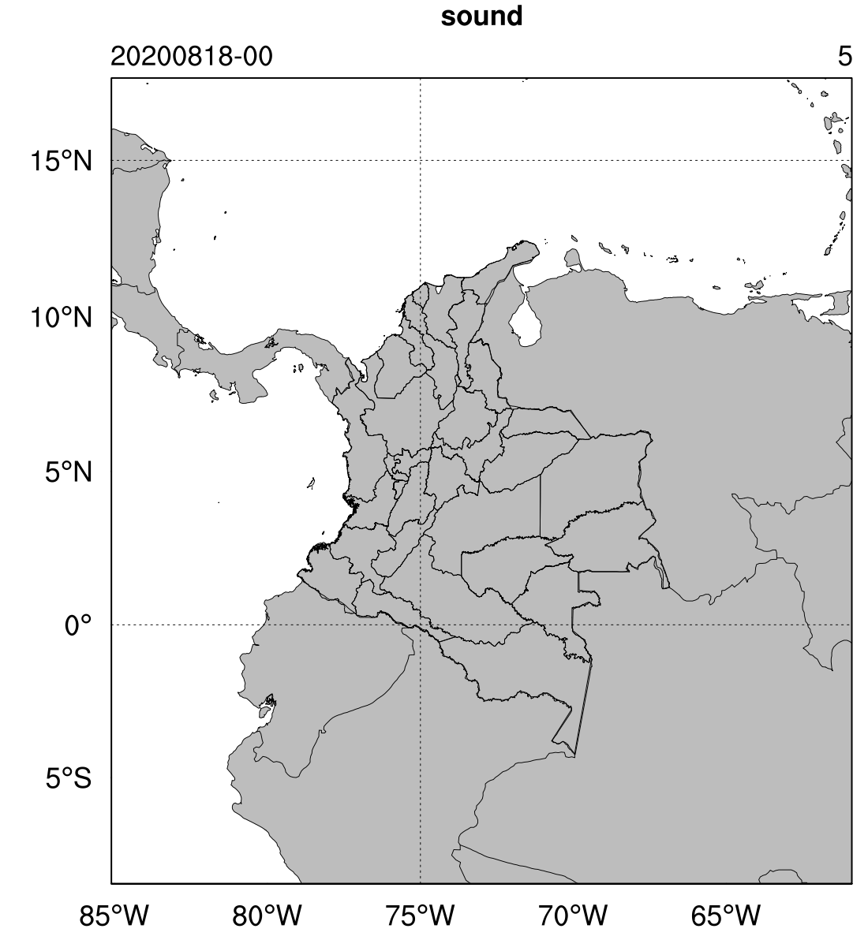
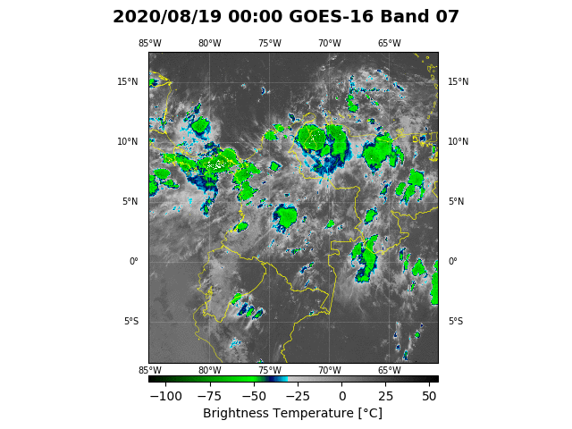
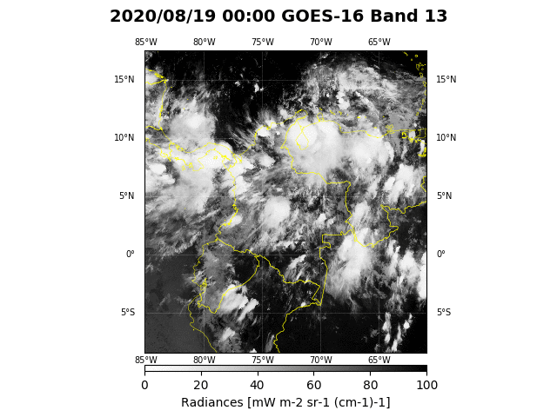
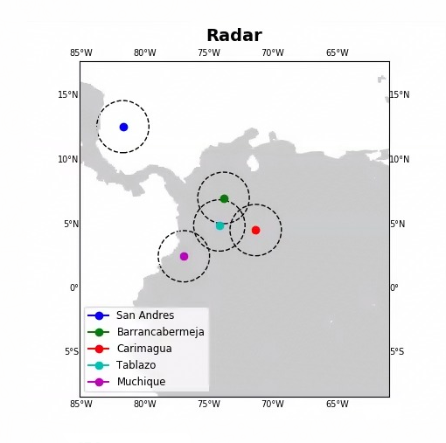
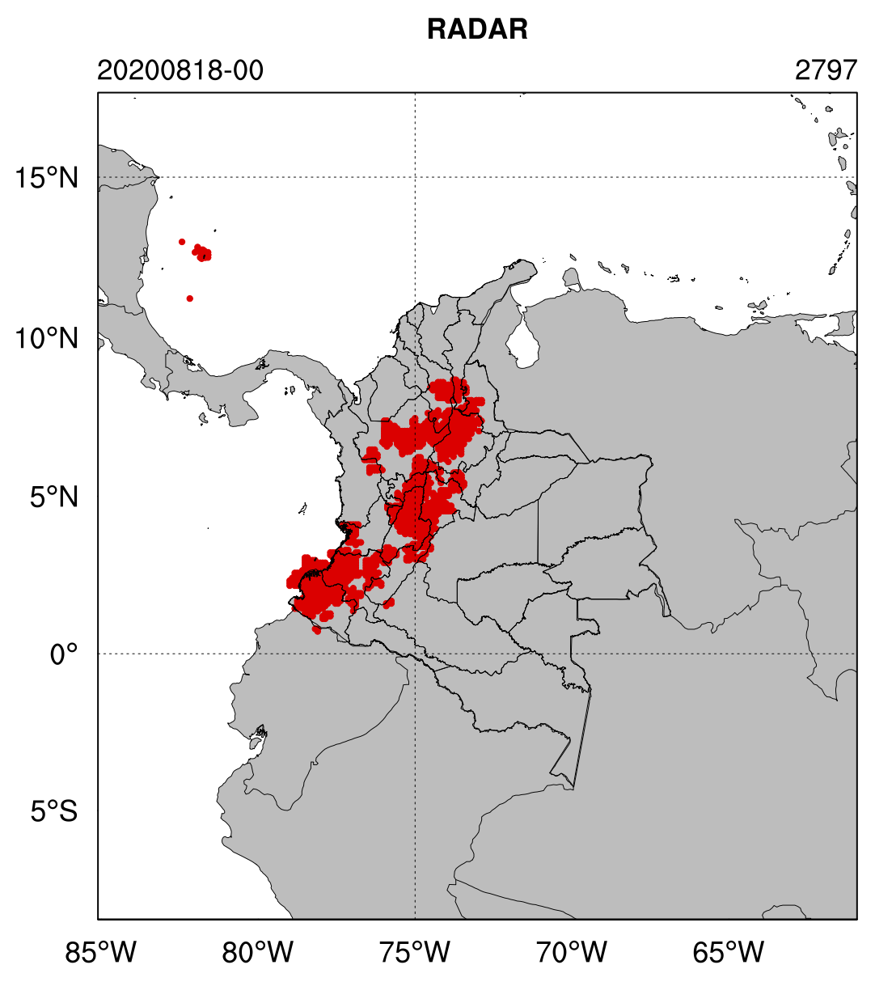
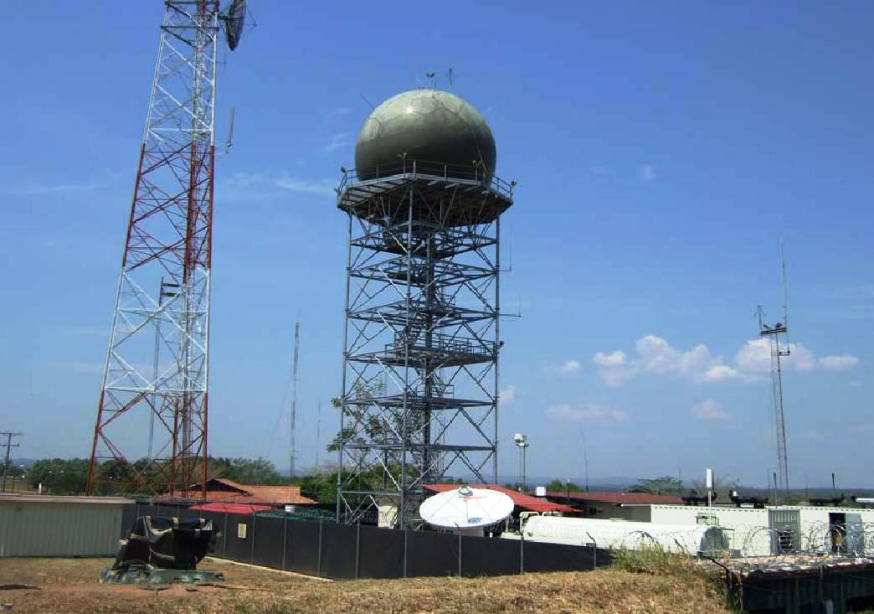
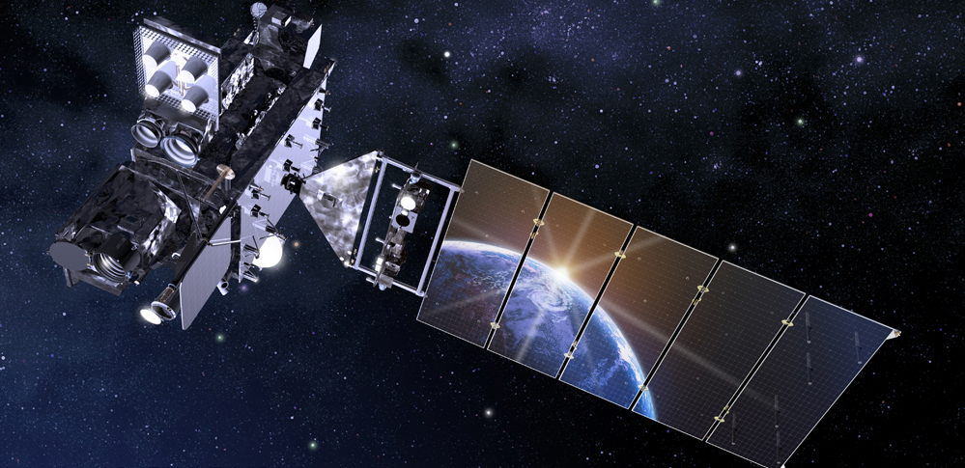
Each observation has its
own characteristics and was neccesary to develop a pipeline
12

Slide 13
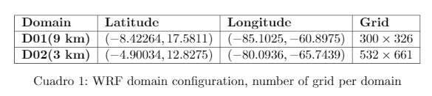
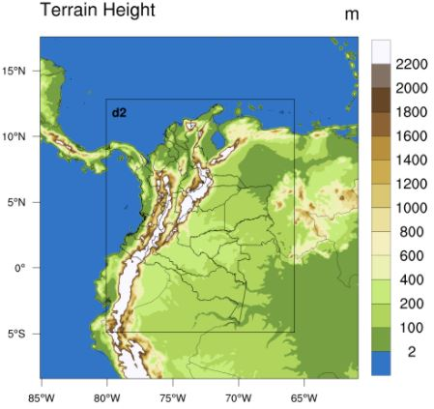
Hipercube matrix
Leveles
Longitude
Latitude
Domain configuration and WRF parametrizations

Slide 14
Hipercube matrix
Time 1
Time 2
Time 73
Leveles
Leveles
Leveles
Longitude
Longitude
Longitude
Latitude
Latitude
Latitude
time

Slide 15
Hipercube matrix
Time 1
Time 2
Time 73
Leveles
Leveles
Leveles
Longitude
Longitude
Longitude
Latitude
Latitude
Latitude
time

Slide 16
Hipercube matrix
Time 1
Time 2
Time 73
Leveles
Leveles
Leveles
Longitude
Longitude
Longitude
Latitude
Latitude
Latitude
time

Slide 17
Pipeline sounding
Download from
http://weather.uwyo.edu/upperair/sounding.html
Generate_matrix.m
Erase label information of the downloaded file for each sounding station
Generate hiper matrix
(Lat,Lon,levels, time )
Save as day_station.mat
Convert to .txt
Load day_station.mat
d2sounds.py – file for bulk download
/home/dirac/Dropbox/2020/WRFDA_FAC_EAFIT/Sondas/Descarga_Sondas/new_download
Read .txt
readtable(<station>.txt)
Validation of the trajectory: save station file as .dat and use pymeteo
For produce files type skewt.pdf

Slide 18
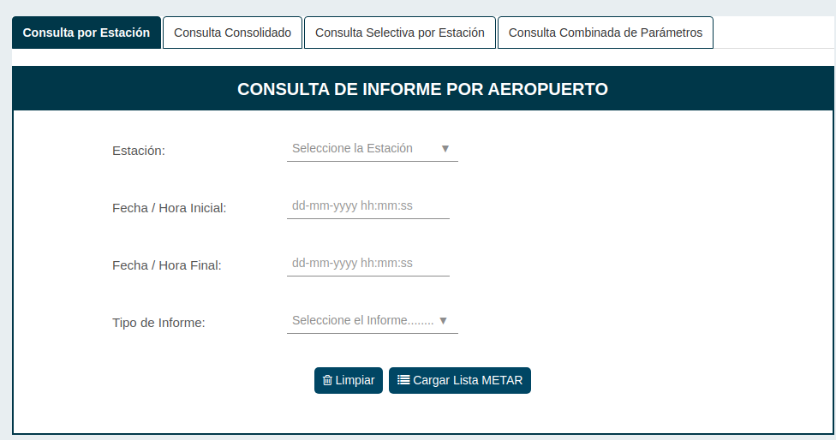
Pipeline METAR
Download
Decode Metar
Hipe Matrix
From IDEAM:
http://www.ideam.gov.co/web/meteorologia-aeronautica/consulta-metar
Select: Station, date/time (start and end), type of report (METAR-SPECI)
GITHUB:
https://github.com/ayarceb/WRFDA_FAC_EAFIT/tree/master/Metar/decode_metar.py
Review the file obtained. Delete information repeat.
Generate hiper matrix with dimension Lat,Lon,levels, time and using the information of the WRFOUT for every variable.
GITHUB:
https://github.com/ayarceb/WRFDA_FAC_EAFIT/tree/master/Metar/decode_metar.py

Slide 19
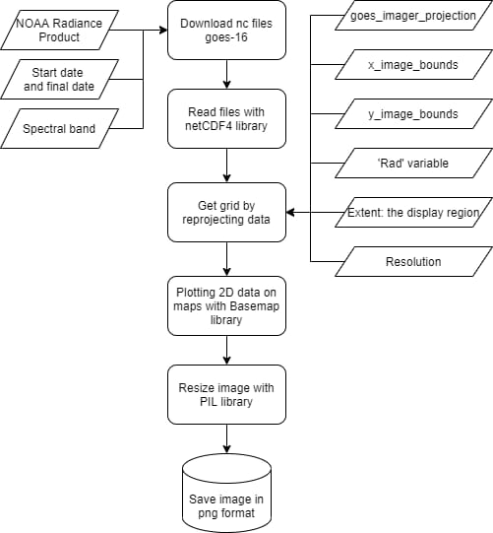
Pipeline GOES

Slide 20
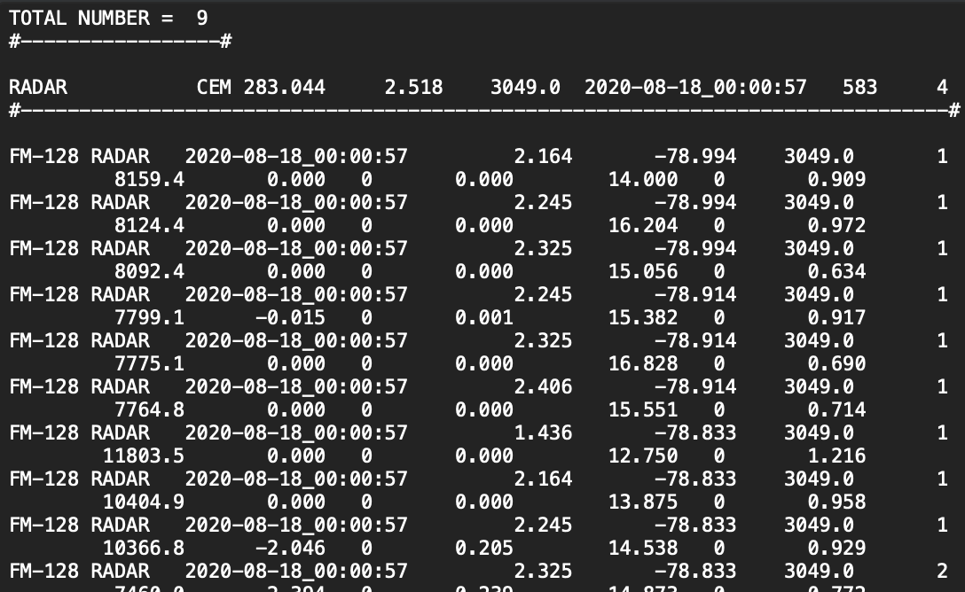
Pipeline RADAR
Download
From SIMFAC:
https://www.simfac.mil.co/imag/RADAR/RAW/ raw files
p2_preparation.py
decodeRADAR.py
Csv_2_matrix
Data radar in csv
Hipe Matrix
Files in little R
Generate a csv matrix with Fecha, Lat,Lon,altura, radial velocity, reflectivity
GITHUB:
https://github.com/ayarceb/WRFDA_FAC_EAFIT/tree/master/RADAR/decodeRADAR.py
Generate hiper matrix with dimension Lat,Lon,levels, time and using the information of the WRFOUT for every variable.
GITHUB:
https://github.com/ayarceb/WRFDA_FAC_EAFIT/tree/master/RADAR/csv_2_matrix.py

Slide 21
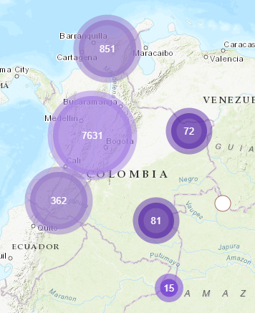

Pipeline IDEAM
Análogo al pipeline del METAR
21

Slide 22
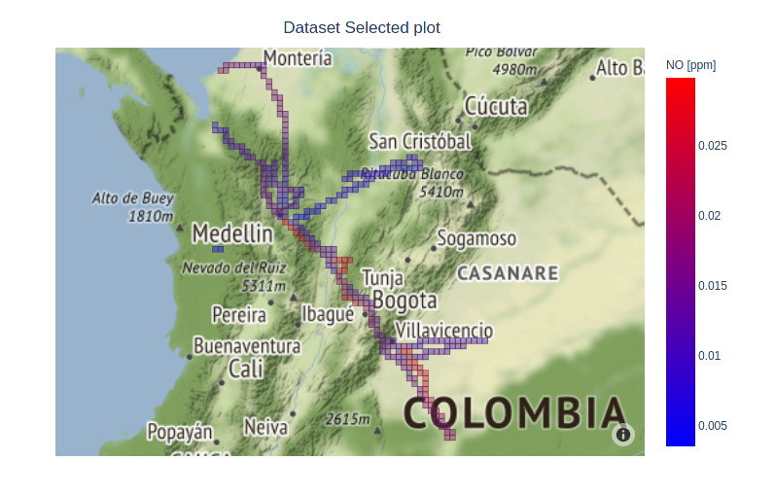
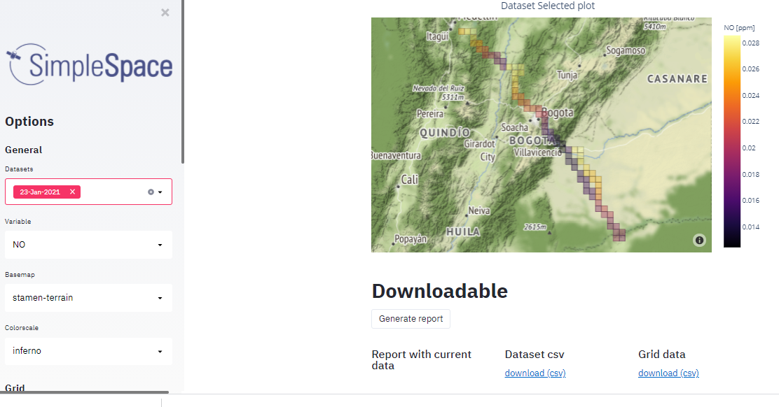
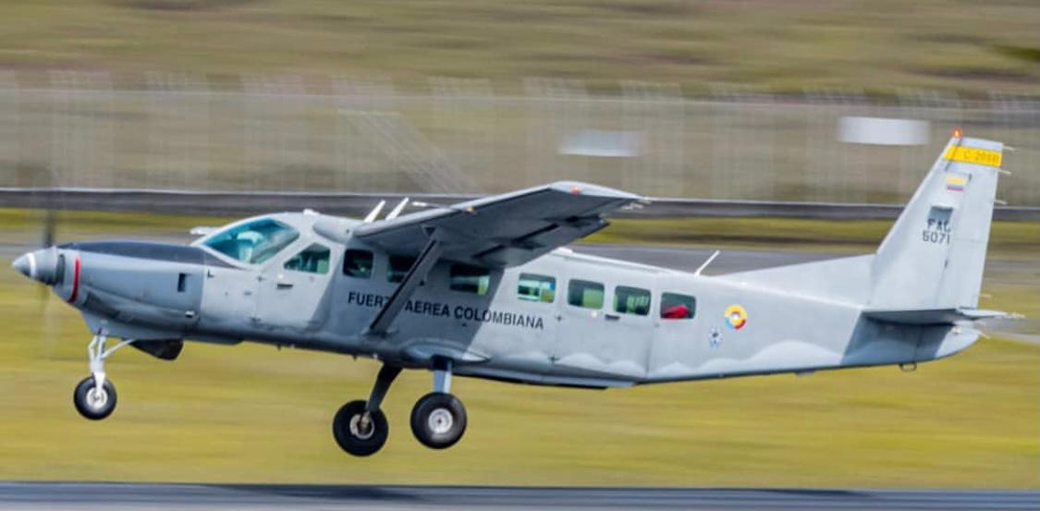
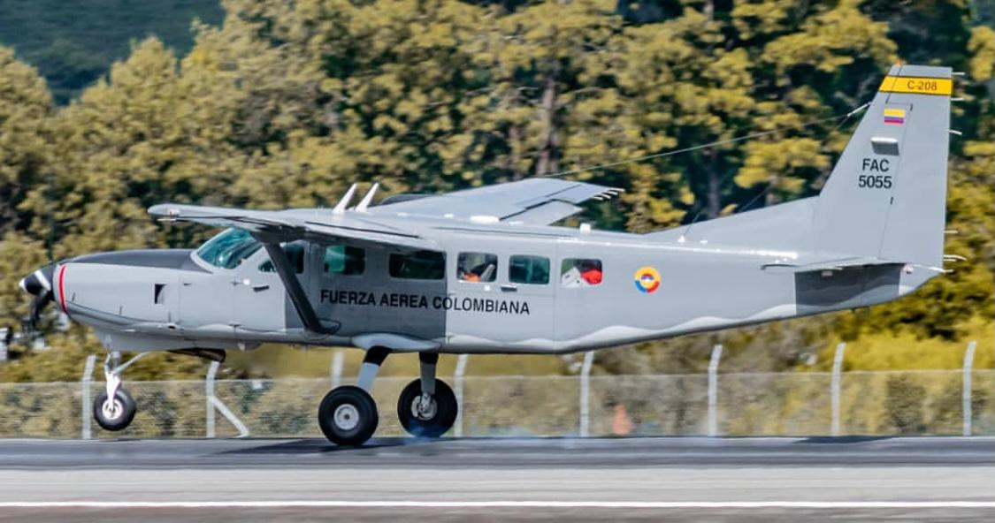
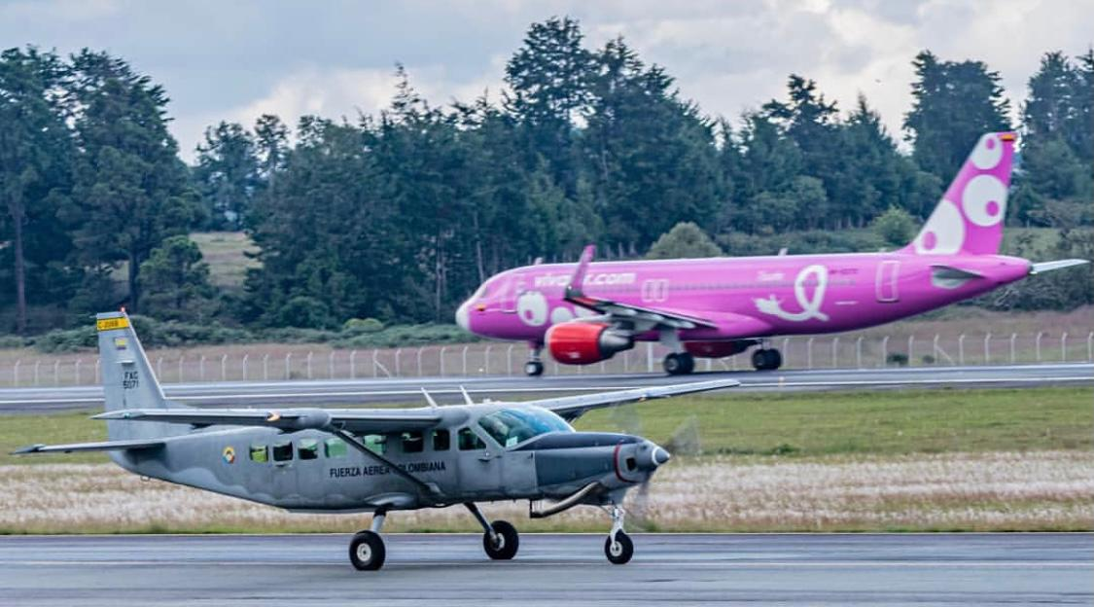
Pipeline Simple
All flights in a map
NO₂ (ppm)
http://3.139.59.142:8501/

Slide 23
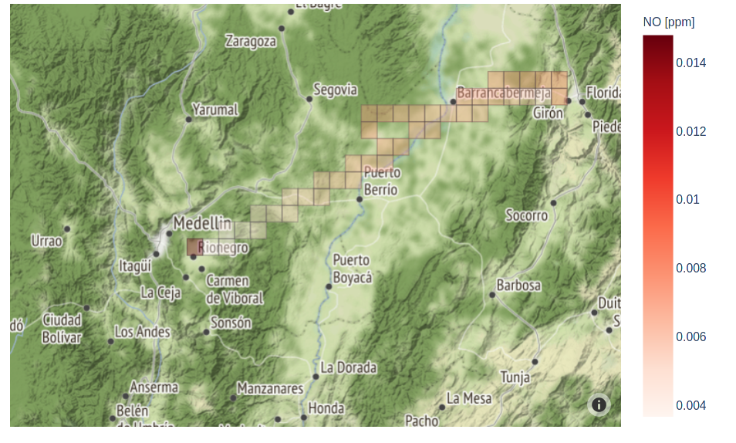
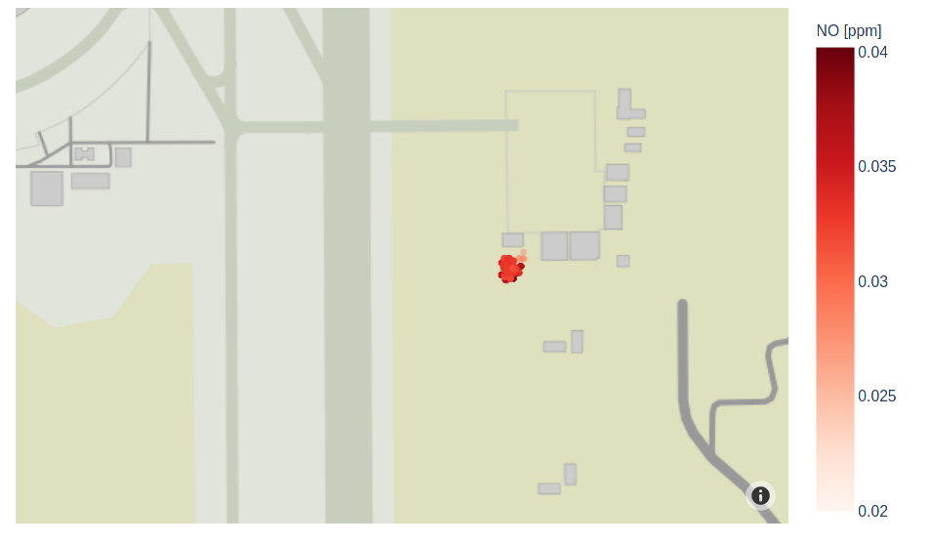
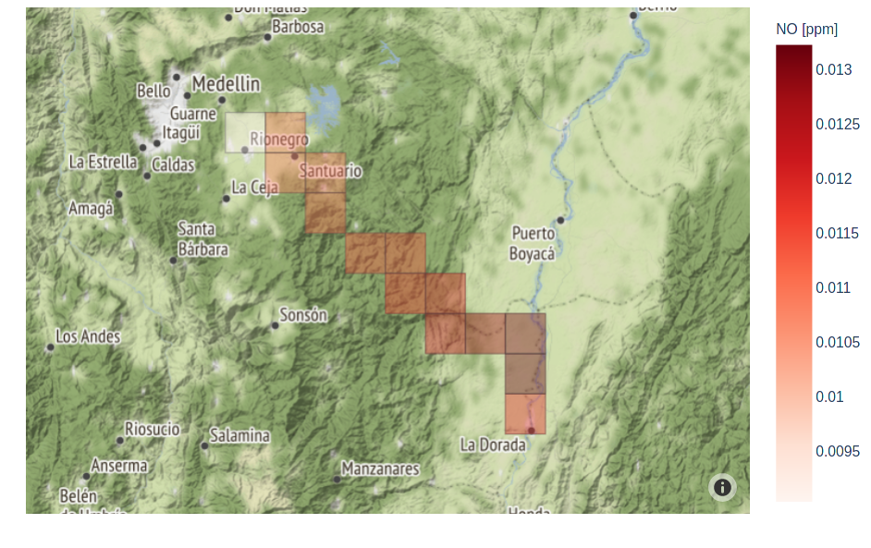
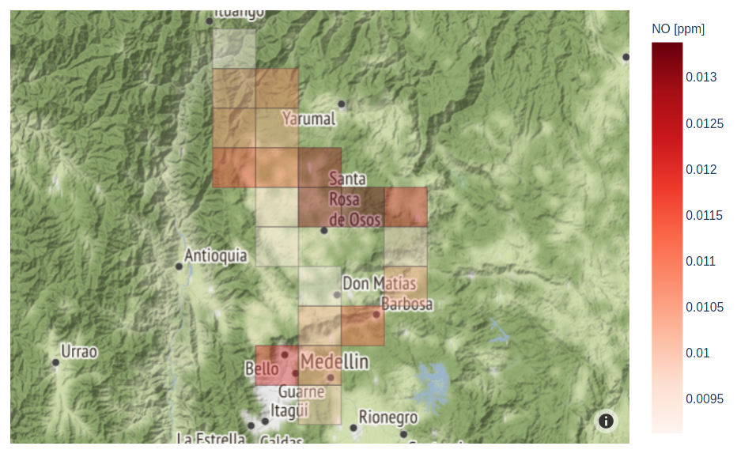
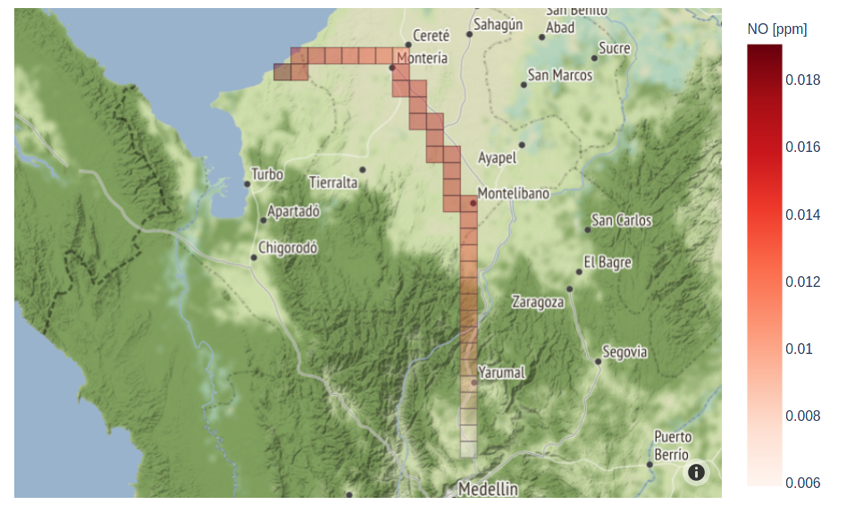
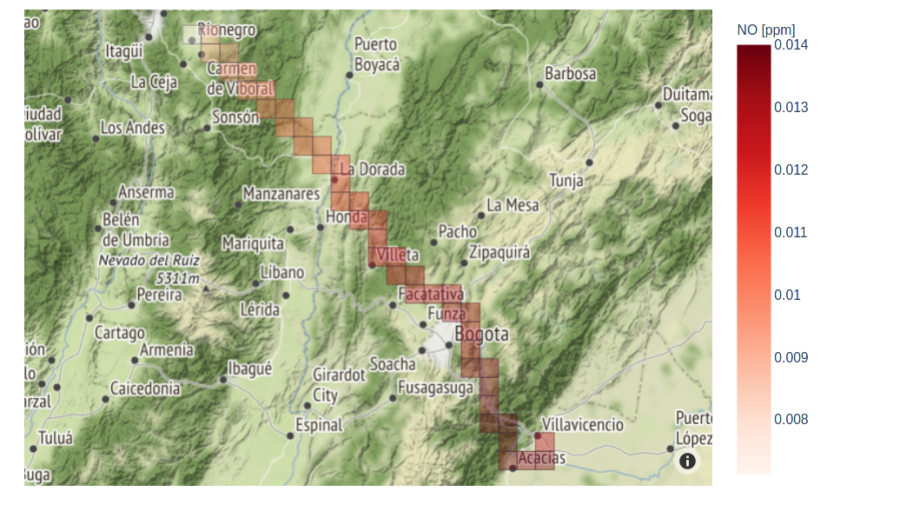
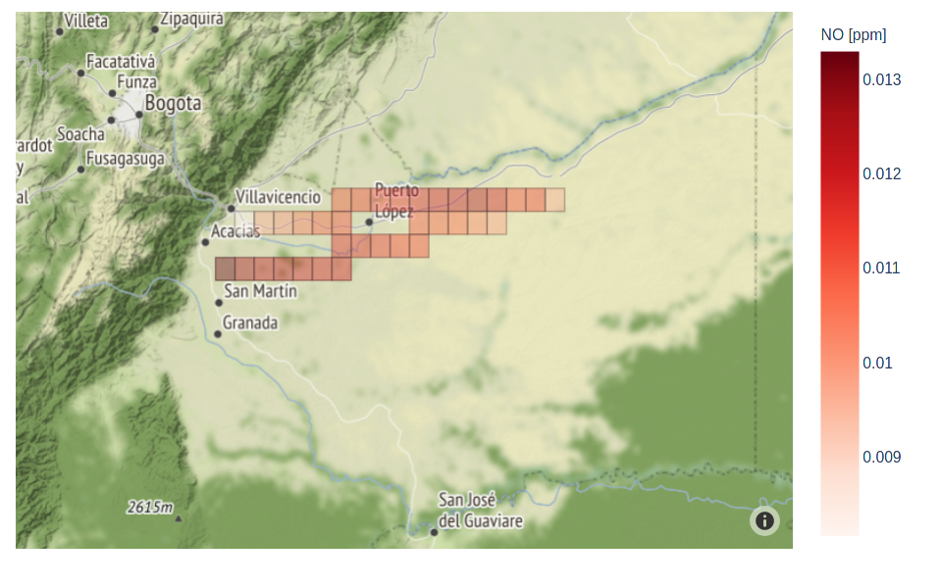
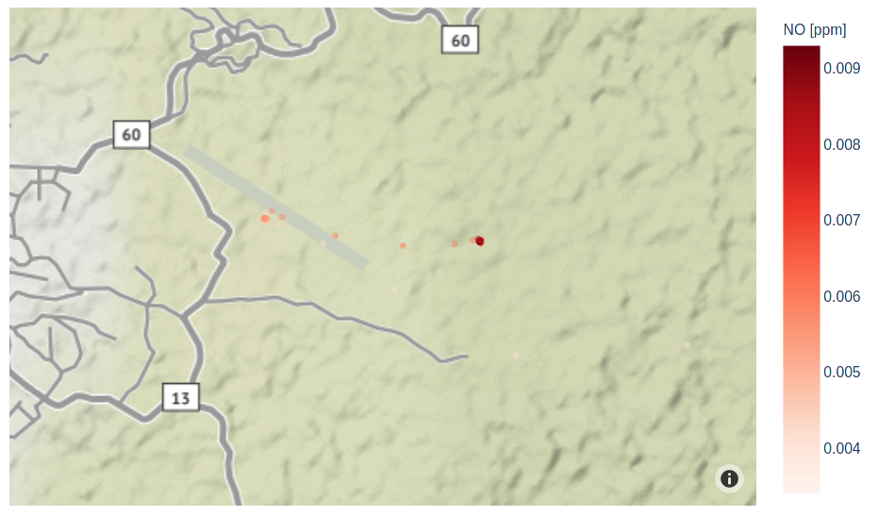
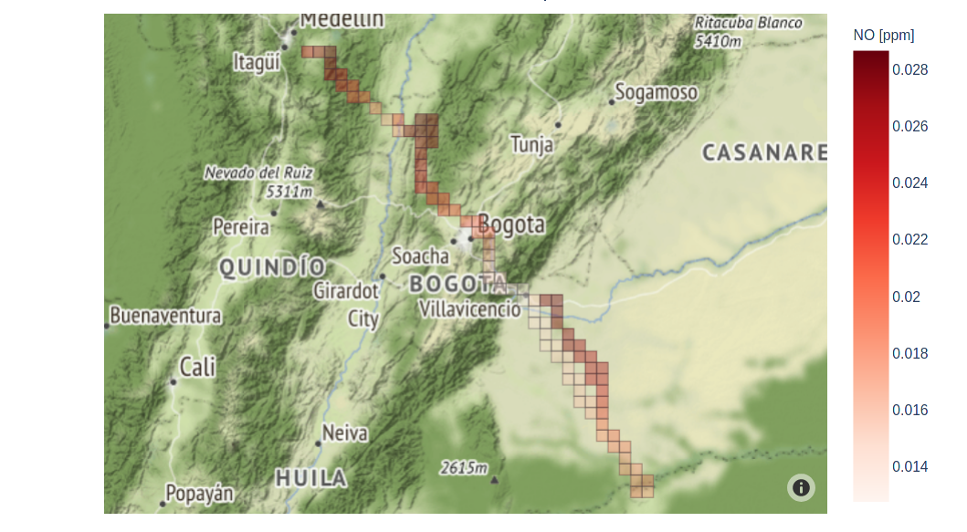
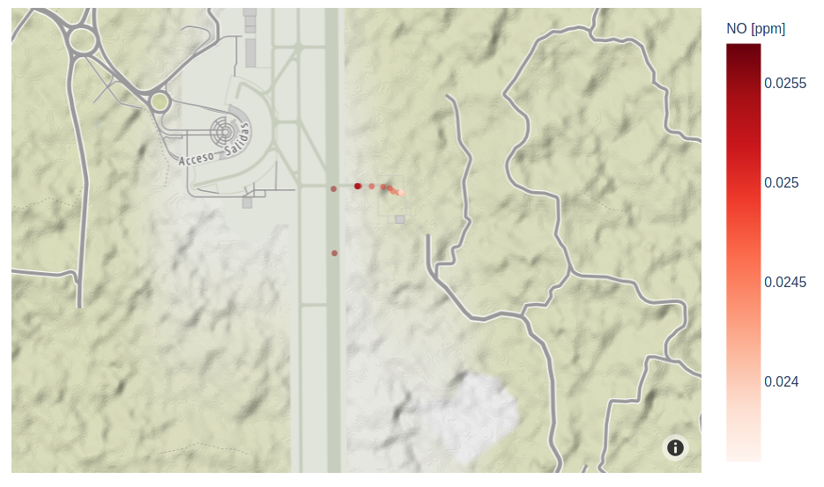
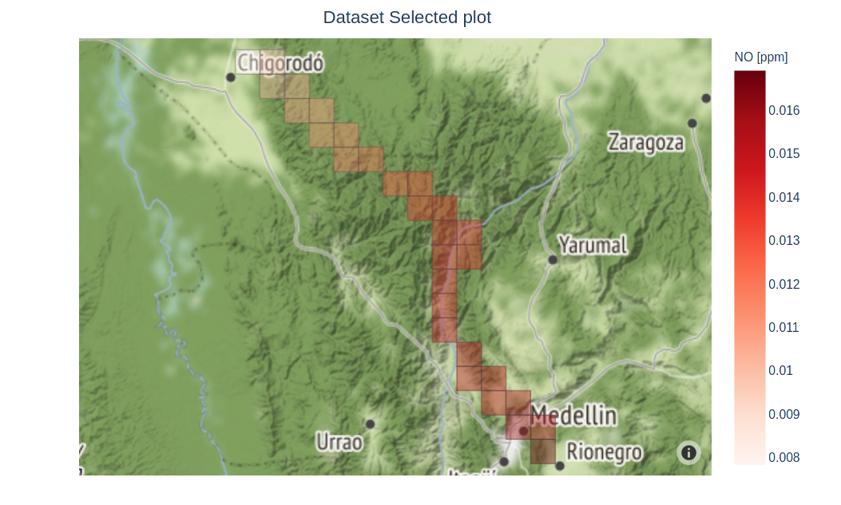
1 nov 2020
2 nov 2020
NO2 (ppm)
10 nov 2020
NO2 (ppm)
13 nov 2020
NO2 (ppm)
NO2 (ppm)
14 Nov 2020
NO2 (ppm)
22 January 2021
16 January 2021
21 January 2021
NO2 (ppm)
NO2 (ppm)
NO2 (ppm)
23 January 2021
NO2 (ppm)
24 January 2021
NO2 (ppm)
27 January 2021
NO2 (ppm)

Slide 24
Pipeline “The system”. observations and models
Time range selection
Observation selection
- Station selection
- Spatial resolution of the cube to generate
user
Model
Observations
WRF
WRFDA
3DVar
Sondas
METAR
Satellite (GOES
Sentinel-5
Sentinel-2)
RADAR
Precipitación
IDEAM
Simple unit
Download
Download
Download
Download
Download
Download
Generate matrix
Generate matrix
Generate matrix
Generate matrix
Generate matrix
Generate matrix
Export different formats
user
CSV, .mat, .nc
Matrix interface
Base de datos
Data assimilation validation purposes
Back end
Robust functional data analysis purposes
Front end

